Slide 1

EMPLOYEE DATA MANAGEMENT SYSTEM

Slide 2
AIM: Employee Database Management System is a software that allows Employee to register itself and allows only admin to access the data and perform various operation on data according to the requirements..
METHODOLOGY: Employees are the backbone of any company therefore their management plays a major role in deciding the success of an organization. Employees Management Software makes it easy for the employer to keep track of all records. This software allows the administrator to edit employees, add new employees, transfer/promote/terminate

Slide 3
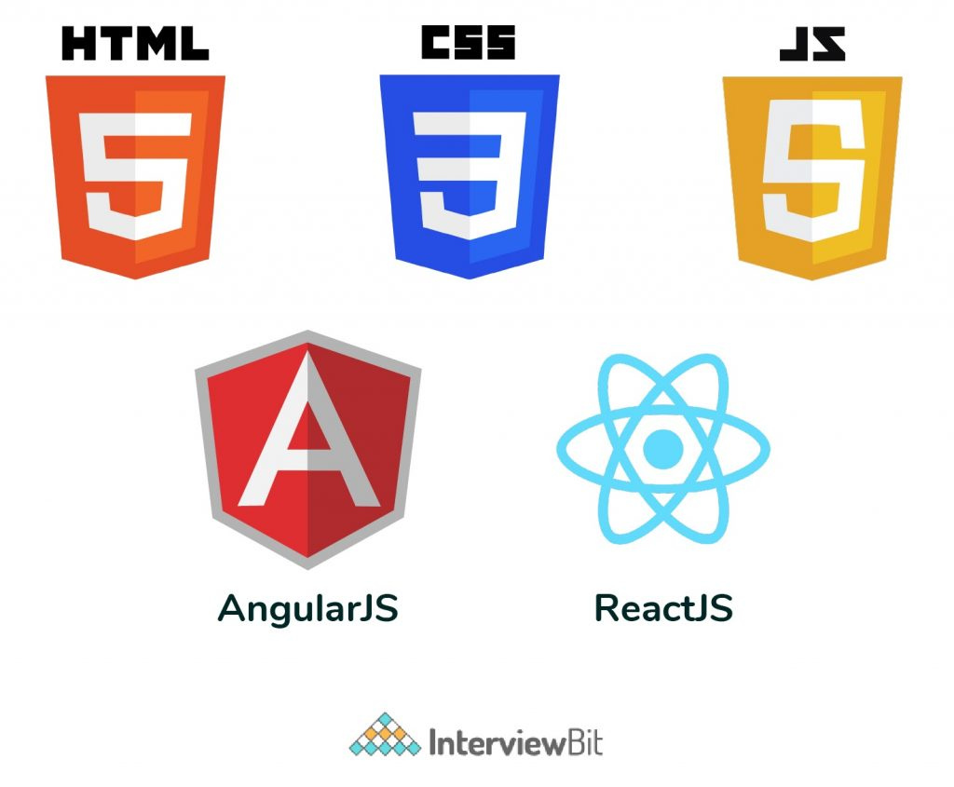
Front End Requirements

Slide 4
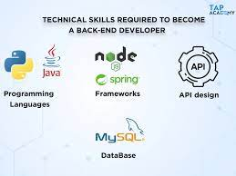
Backend Requirements

Slide 5
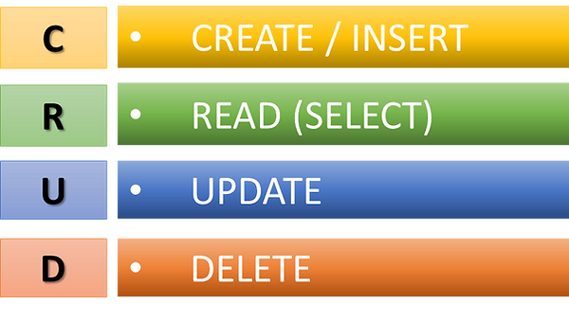
Crud Operations

Slide 6
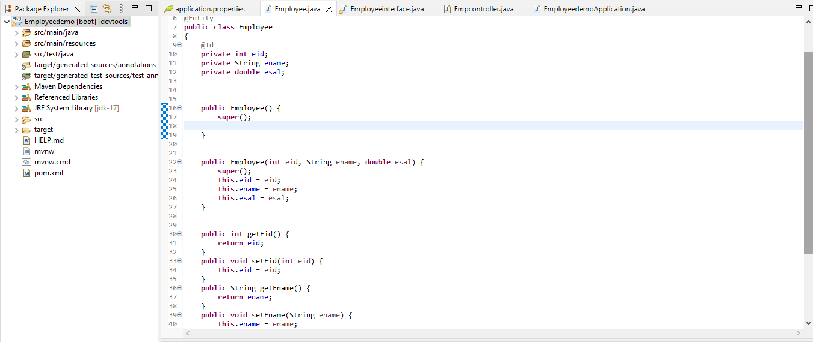
STS Employee Class

Slide 7
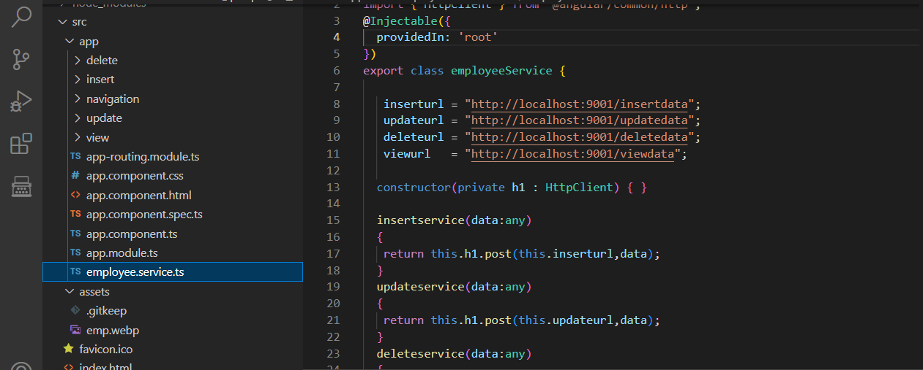
Service page

Slide 8
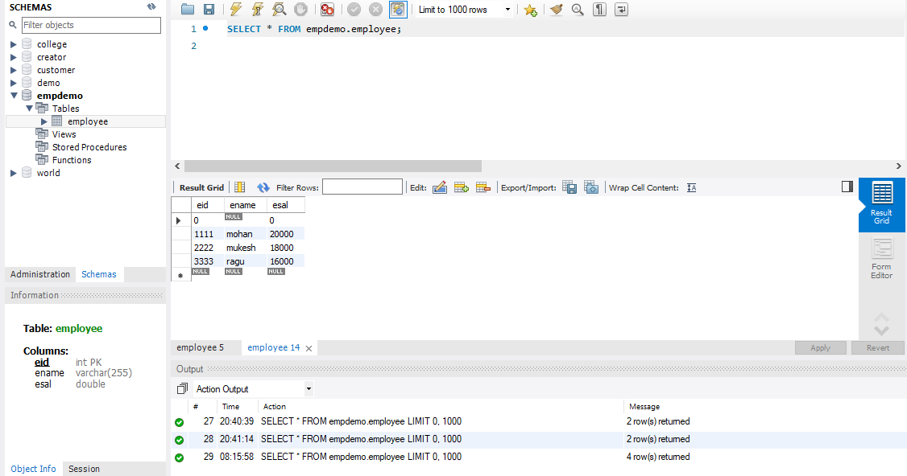
Database page

Slide 9
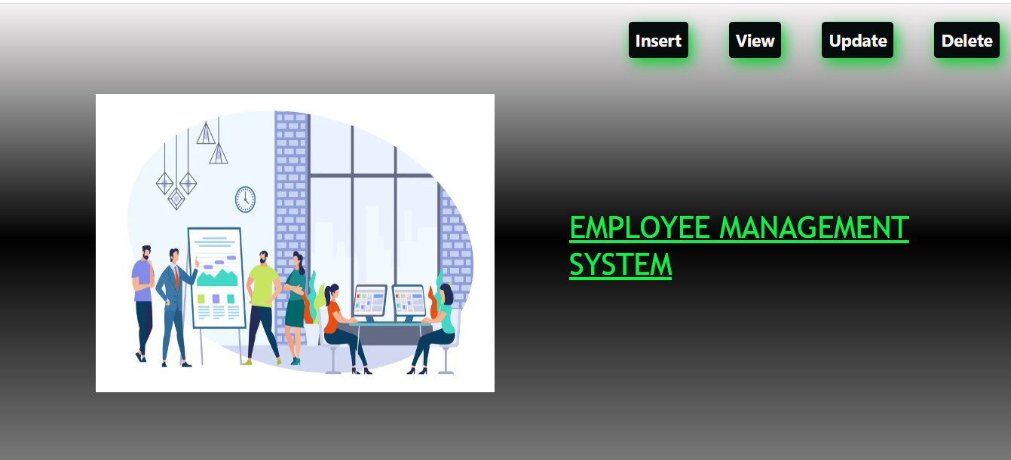
Home page

Slide 10
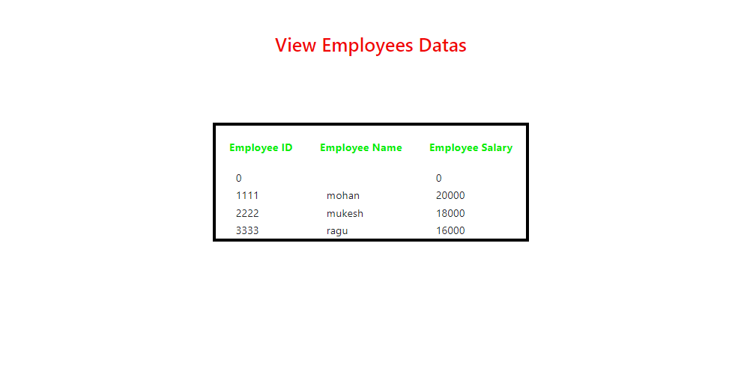
View page of Employees

Slide 11
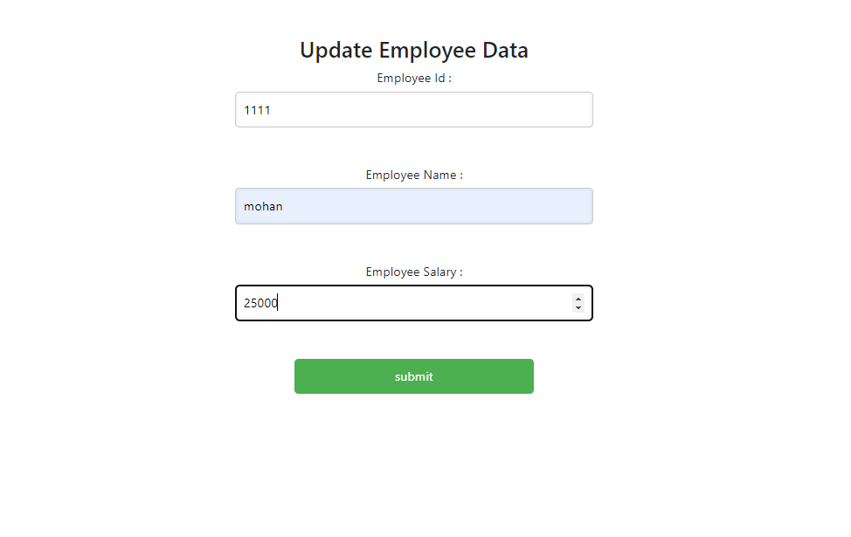
Updating Employee Data

Slide 12
Scope & Future
An employee management system or EMS is a tool that helps improve employee satisfaction and productivity to help a company achieve their overall goals. These tools help monitor, assess and control employees' working hours and efficiently utilise human resources. Enhanced learning experience: By using a Employee management system with CRUD operations,
Companies can provide Employees with a better learning experience. For example, Employees can access their Admin and resources online, and receive feedback and grades in real-time.

Slide 13

Thank you …..

